Slide 1

Chapter 3: Get something running
Summary from book “Beginning Rails 3 - Cloves Carneiro Jr_”

Slide 2
Sample code
Repo: git@github.com:pingovn/pingo-rails-basic.git
Branch: chapter 3

Slide 3
Overview
In this chapter, you build a simple blog application that lets you create and publish articles, like WordPress or Blogger. The first iteration focuses on the basics: creating and editing articles.

Slide 4
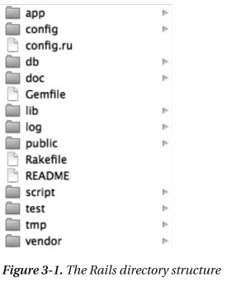
Creating the Blog Application
$ rails new blog
Important folders/files
Folder | Description
app | All components of your application → Most of time, you will work here
config | Configuration files for all components of your application. Ex: config for database, environments
db | Files related to the database you’re using, and a folder for migrations such as migrations
log | Log files that your application may require.
public | Static assets served by your application, such as images, JavaScript, and CSS files.
Gemfile | Keep information of userd gems, versions, where to download gems (ex: at RubyGem or github.com)
README | Explain your project such as how to install, how run,… in case that you have some special softwares needed.

Slide 5
Bring up database
Setting up database
Listing 3-1. The config/database.yml File
development: this setting is for “development” env
adapter: sqlite3 we use sqlite3 for database
database: db/development.sqlite3 database name
pool: 5 maximum parallel connections
timeout: 5000 timeout for db queries/accesses
Create database from setting
$ rake db:create
The database for “development” environment will be created !
rake is build language for Ruby, and Rails uses it to automate several tasks. You could create your own rake

Slide 6
LAB 1
We should have 3 kinds of databases for a Rails application.
  Development: for you, developers to develop features
  Test: for running test automatically
  Production: for production (public to internet)
  Note: when you run the test (under “test” environment), test records will be created & destroyed multiple times. If you use same database with development or production, database will be broken.
LAB 1: based on “development” database, please create database for “test” & “production” environment with below conditions
  Test database : db/test.sqlite3
  Production database : db/production.sqlite3

Slide 7
LAB 2
Use below command to generate all databases
  $ rake db:create:all
  $ rake db:migrate
  If there is no error, congratulation !
  You finished this LAB

Slide 8
Create article model
$ rails generate model Article
Take a look the file
Listing 3-2. The db/migrate/20100223220648_create_articles.rb File
class CreateArticles < ActiveRecord::Migration
def self.up up method is executed when migrate (rake db:migrate)
create_table :articles do |t| table is created
t.string :title there fields are not exist yet. We have commands
t.text :body to create them automatically. But at this step, could
t.datetime :published_at you please help mentors to add them. Thanks !!!
t.timestamps
end
end
def self.down down method is executed when rollback (rake db:rollback)
drop_table :articles table is deleted
end
end
$ rake db:migrate Hey mentor, why we need “down” method here???

Slide 9
Create article model (cont)
$ rails generate controller articles
A lot of files are created :’(
Ignore them now, thanks !
We will be back to review them soon !

Slide 10
Scaffolding
We did below things
  Create a model Article
  Add some fields to it (title, body, published_at)
  Create controller
  We could do the same thing, with only 1 command
  $ rails generate scaffold Article title:string body:text published_at:datetime --skip-migration

Slide 11
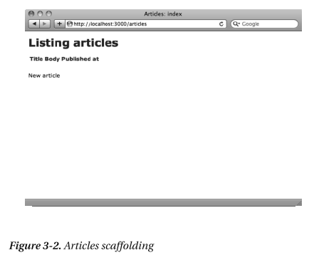
Bring up Rails server
$ rails server
  “development” environment is up by default
Use your favorite browser (Firefox, Chrome, IE ☹) & visit
  http://localhost:3000/articles
  If you see similar page as →
  Congratulation !

Slide 12
Scaffold is super fast
Visit http://localhost:3000/articles/new
Rails created everything for me just by using “scaffold”.

Slide 13
Add more fields
But I forgot to create 2 fields excerpt (string) and location (string).
Hmm, did I need to remove data & re-run “rails gerate scaffold”.
Luckily, we just need to add them by below command
$ rails generate migration add_excerpt_and_location_to_articles excerpt:string location:string
Listing 3-4. The db/migrate/20100223232337_add_excerpt_and_location_to_articles.rb File
class AddExcerptAndLocationToArticles < ActiveRecord::Migration
def self.up
add_column :articles, :excerpt, :string
add_column :articles, :location, :string
end
def self.down
remove_column :articles, :excerpt
remove_column :articles, :location
end
end
$ rails db:migrate

Slide 14
Tips
We create a model, controller,… by scaffold. Then, we added some fields to the table.
Certainly, if you “modelling” your design well, you just need one command for everything done. There are some unclear files now, skip it for now ☺
$ rails generate scaffold Article title:string location:string excerpt:string body:text published_at:datetime --skip-migration

Slide 15
Validation
Step 1: Please visit “new” url & create an article with BLANK title & body. Then, submit. Hm, submission is done. But are you fine with an article that has empty title & body :’(
Step 2: Avoid this by validation
=== app/models/article.rb ===
class Article < ActiveRecord::Base
validates :title, :presence => true please add these 2 lines
validates :body, :presence => true
end
Step 3: Repeat step 1 again. WOW, an empty title or body could not be saved to database V(^ ^)V

Slide 16
Summary
In this chapter, we learned
  Create a new project (rails new)
  Create a model (rails generate model)
  Create a controller (rails generate controller)
  Make migration (db/migrate/…)
  Add fields to table (rails generate migration)
  Or, do from 2-5 by scaffold (rails generate scaffold ….)
  Update database from migration (rake db:create, and rake db:migrate)
  You also could add a simple validation to avoid a stupid article saved
  We still not understand many things :’(
  Don’t worry, that’s why we should meet together next days for making them clear.
  Before going home, could you please finish the final LAB of today (next slide)

Slide 17
LAB 3
Remove your project folder
Only use 1 scaffold command, can you create article model, controller, table (title:string, location:string, excerpt:string, body:text, published_at:datetime) & bring up database by rake db:create or rake db:migrate
Then, add a simple validation to avoid empty title & body.
Register all to git repo
Mentors will support you !

